Slide 1
Valid Statistical Analysis for Logistic Regression with Multiple Sources
Rob Hall (Dept of Machine Learning, CMU)
Joint work with Yuval Nardi and Steve Fienberg
http://www.cs.cmu.edu/~rjhall
rjhall+@cs.cmu.edu

Slide 2


Setting
Patient ID | Tobacco | Age | Weight | Heart Disease
0001 | ? | ? | 170 | ?
0002 | ? | ? | 150 | N
0003 | N | 45 | 165 | N
Patient ID | Tobacco | Age | Weight | Heart Disease
0001 | Y | 35 | ? | Y
0002 | Y | 40 | ? | ?
0004 | N | 50 | 165 | N
Logistic regression (or any glm)

Slide 3
Alternatives
Multiple organizations with databases want to do a statistical calculation (e.g., regression).
Each would benefit by mining the pooled data.
Not allowed/willing to share data (e.g., HIPAA).
Share transformed data?
Secure multiparty computation?

Slide 4

In an Ideal World
Hospitals send data to a “trusted party.”
“Trusted party” computes regression, sends same coefficients back to each hospital.
This is an “ideal” scenario - trusted parties don’t exist.
Using cryptography, we can do the computation as if they did.

Slide 5
Secure Multiparty Computation
A protocol computes a “functionality:”
Messages are exchanged and coins are flipped, each party has a “view”
It is secure whenever the messages can be simulated (“semi-honest” model):
Party 1’s data
Party 2’s data
Each party gets a copy of the output

Slide 6
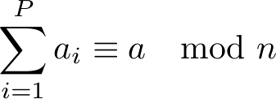


Additive Random Shares
Split a secret quantity so each party has a share:
Marginally each share is uniformly distributed on .
Messages consisting of shares are easy to simulate.
Finite precision reals only slightly trickier.

Slide 7


Multiplication
Local product
Different parties
Using homomorphic encryption:
encrypts
computes:
decrypts:
is encrypted when sent, so message is easy to simulate.
are uniform in .

Slide 8




Linear Regression
The MLE is:
Compute Shares of ,
Secure matrix inversion
Similar to Newton’s method on the function:
Secure matrix multiply.
Modular addition of shares.

Slide 9



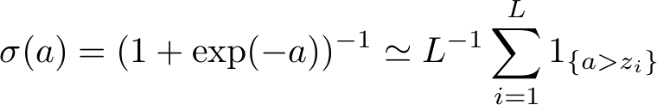
Logistic Regression (IRLS)
Newton-Raphson iterates:
Approximate sigmoid by the empirical CDF:
Secure computation of
“greater than” is well known.
Approximation error decreases with .

Slide 10
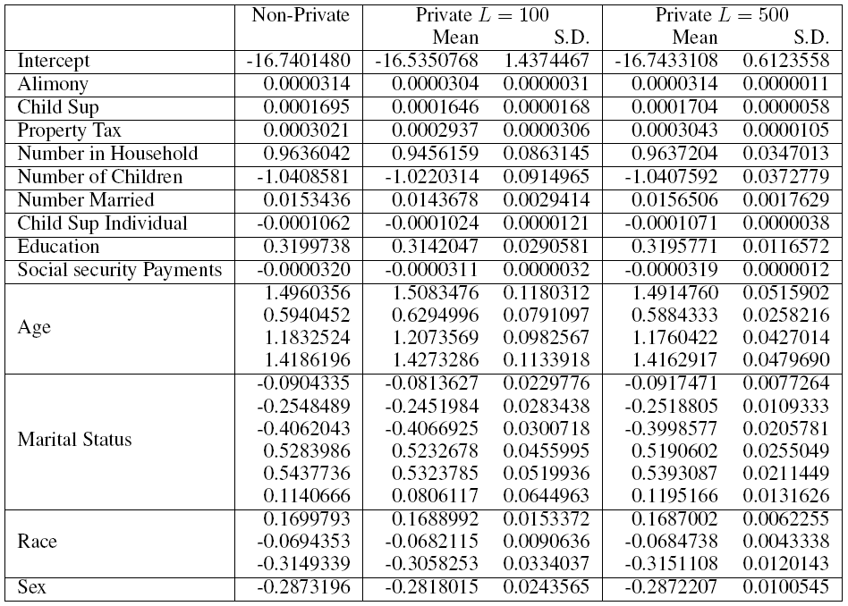
CPS - Experimental Verification

Slide 11
CPS - Experimental Verification
No. in Household | 0.96 | 0.95 | 0.09 | 0.96 | 0.03

Slide 12
CPS - Experimental Verification
Age(3) | 1.18 | 1.20 | 0.10 | 1.18 | 0.04

Slide 13
Ongoing Work
Faster approximations to logistic functions.
Record linkage (assumed here).
Imputation of missing data.
Secure computation of goodness-of-fit statistics.
Log-linear models.
Other GLMs.

Slide 14
Questions
For the technical details and a working implementation please see:
http://www.cs.cmu.edu/~rjhall/slr

